Slide 1

Private Image Security (PIS) Using Steganography (Image processing)
-we respect your privacy
Department of Software Engineering
Nepal College of Information Technology
Balkumari, Lalitpur, Nepal
Submitted by:
Sanjaya Adhikari,14731
Mithun Adhikari, 14748

Slide 2
Agenda
PIS: Introduction
Problem Statement
Significance of Study
Objectives
Scope and Application
Proposed Methodology
Use Case Diagram

Slide 3
PIS : Introduction
In today’s context, Security of confidential data is most important.
Native application(Android/ iOS )
platform which Provides security of confidential (private) Image
What we get? – image within image
Notes:
In this era, The security of confidential data is everything, that data might be your private image, your ATM pin no, your bank details.
To provide you a better security, We proposed a cross platform ( Android and iOS) based image processing application

Slide 4
PIS : Problem Statement
Nowadays, People are sharing Private image. They face problem of getting leak . How to know From where and who leaked it?
How can we cover a message secretly to the image?
How to claim/prevent from copyright issues.
How can we send a message secretly to the destination ?
How to extract covered message from previous image?

Slide 5
PIS : Significance of Study
The study of this project finds the solution of the problem arise previously
Using steganography, information can be hidden in carriers such as images, audio files, text files, videos and data transmissions.
What is Steganography?
Technique of hiding data within another data
What is Steganalysis?
Technique of extracting hidden data from stego-data

Slide 6
PIS : Objectives
Secure transmission of confidential image or sensible data.
To claim the copyright and be safe from copyright issues.
To trace the image who leaked it.
Establish your identity.
Adding Digital signature on image.
To destroy the sensible data or watermarks from the carrier image.
You cannot extract the hidden file from any other software.

Slide 7
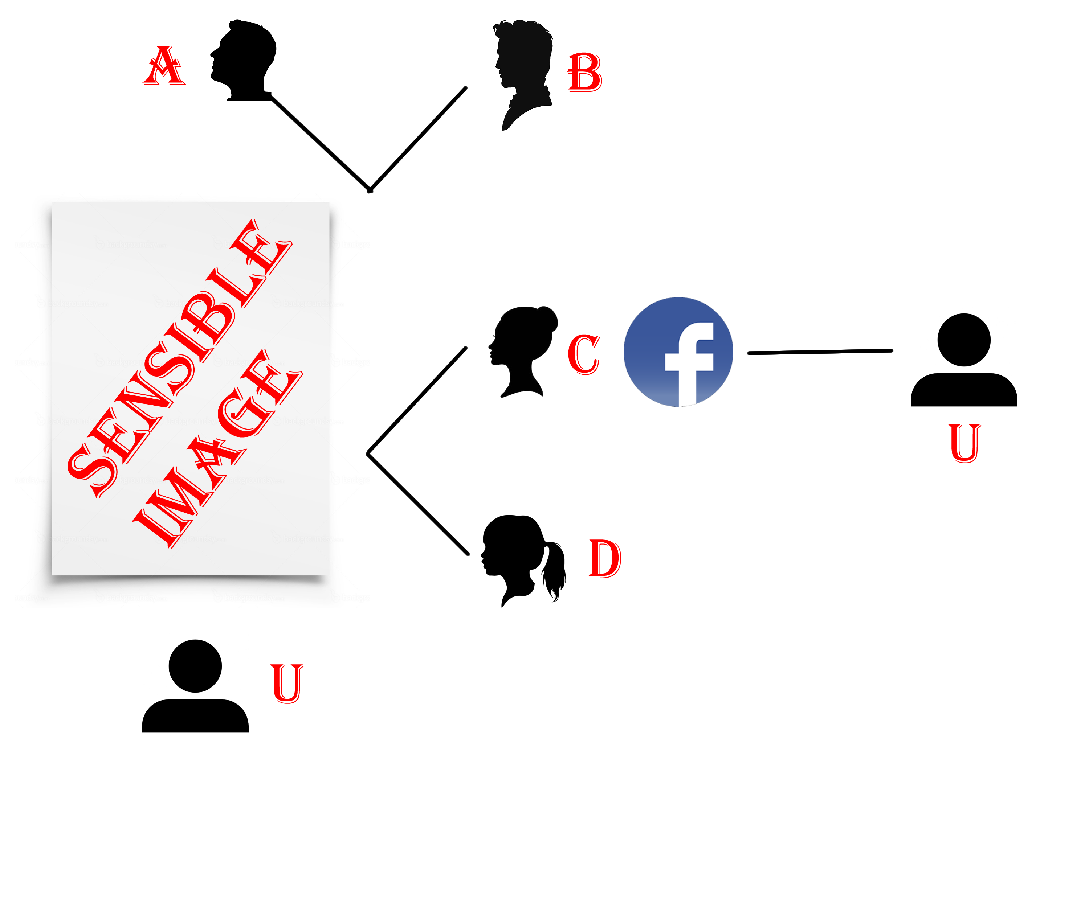
PIS : Scope and Application
Picture is worth of thousands words
Fig: Issues of security ‘ When sharing private image with others’

Slide 8
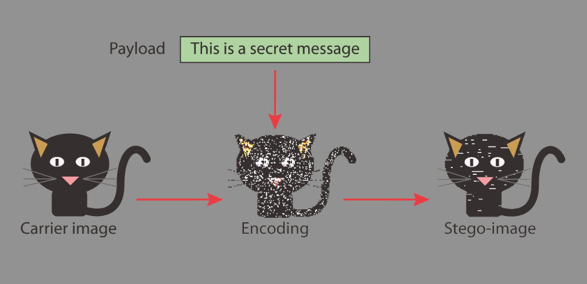
PIS : Scope and Application
Fig: Encoding the secret message with in dummy image
Since Everyone Can Read, Encoding Text
In Neutral Sentences Is Doubtfully Effective
‘Secret inside’
Fig: Hiding the information within text

Slide 9
PIS : Scope and Application
Securely storing sensitive data, such as hiding system passwords or keys within other files.
Difficult to detect.
Network surveillance and monitoring systems will not flag messages or files that contain Steganography data.
Safe Emails
Use of the tool is easy

Slide 10
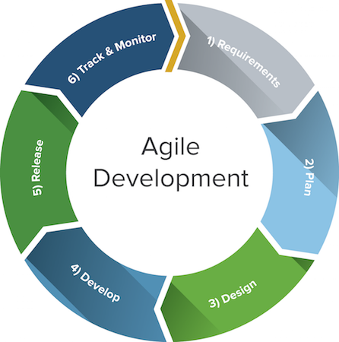
PIS : Proposed Methodology
Agile Methodology
Develop an overall model
Build a features list
Plan by feature
Design by feature
Build by features

Slide 11
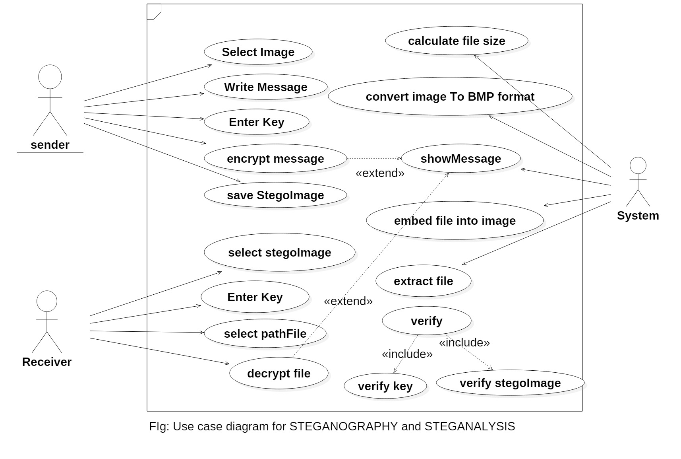
PIS :Use-case diagram

Slide 12
No?
audience.ask(questions);
Thank You Everyone !

